Slide 1


Heart Failure: Physiology and Management
Katy Bonner
Senior Physiotherapist in Cardiac Rehabilitation
Harefield Hospital
Guy’s and St Thomas’ NHS Foundation Trust

Slide 2

Aims of the session:
Speaker introduction
To recap on the structure and function of the healthy heart.
To be able to define the term ‘Heart Failure’ and review the causes of Heart Failure.
To understand how Heart Failure is classified
To understand the pathophysiology in HFrEF, HFmrEF and HFpEF
To be aware of the management of patients with heart failure, both pharmacological and non-pharmacological.

Slide 3
Speaker Introduction
Senior Physiotherapist specialising in Cardiac Rehabilitation
Part of a multi-disciplinary team – led by a consultant physiotherapist, including physiotherapists, exercise instructors, cardiac exercise physiologists, assistant practitioners, cardiac specialist nurses and smoking cessation clinicians
Based at Harefield Hospital, with a private service running at the Royal Brompton Hospital
Harefield Hospital is one of the largest and most experienced centres in the world for heart and lung transplantation.
One of seven heart transplant centres in the UK.

Slide 4
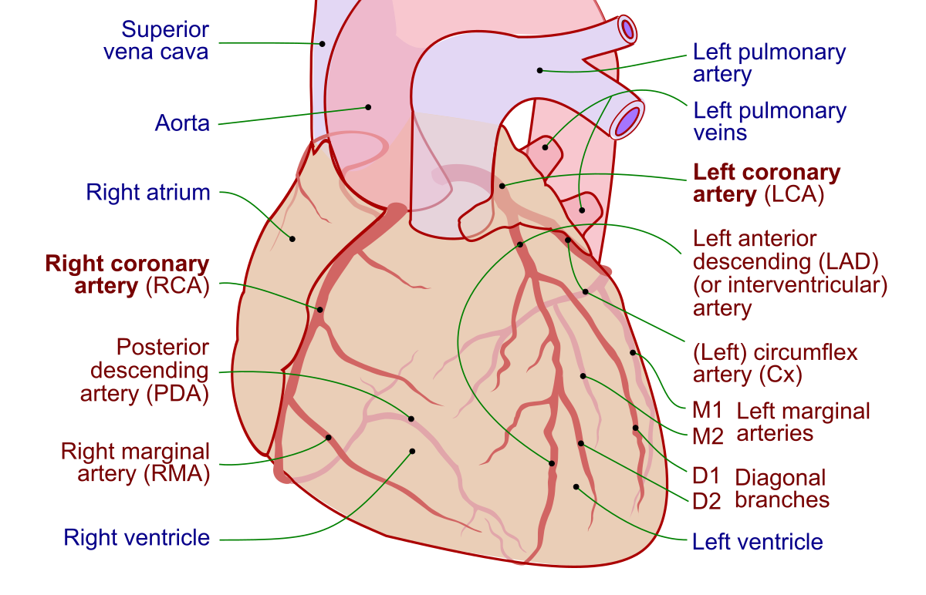
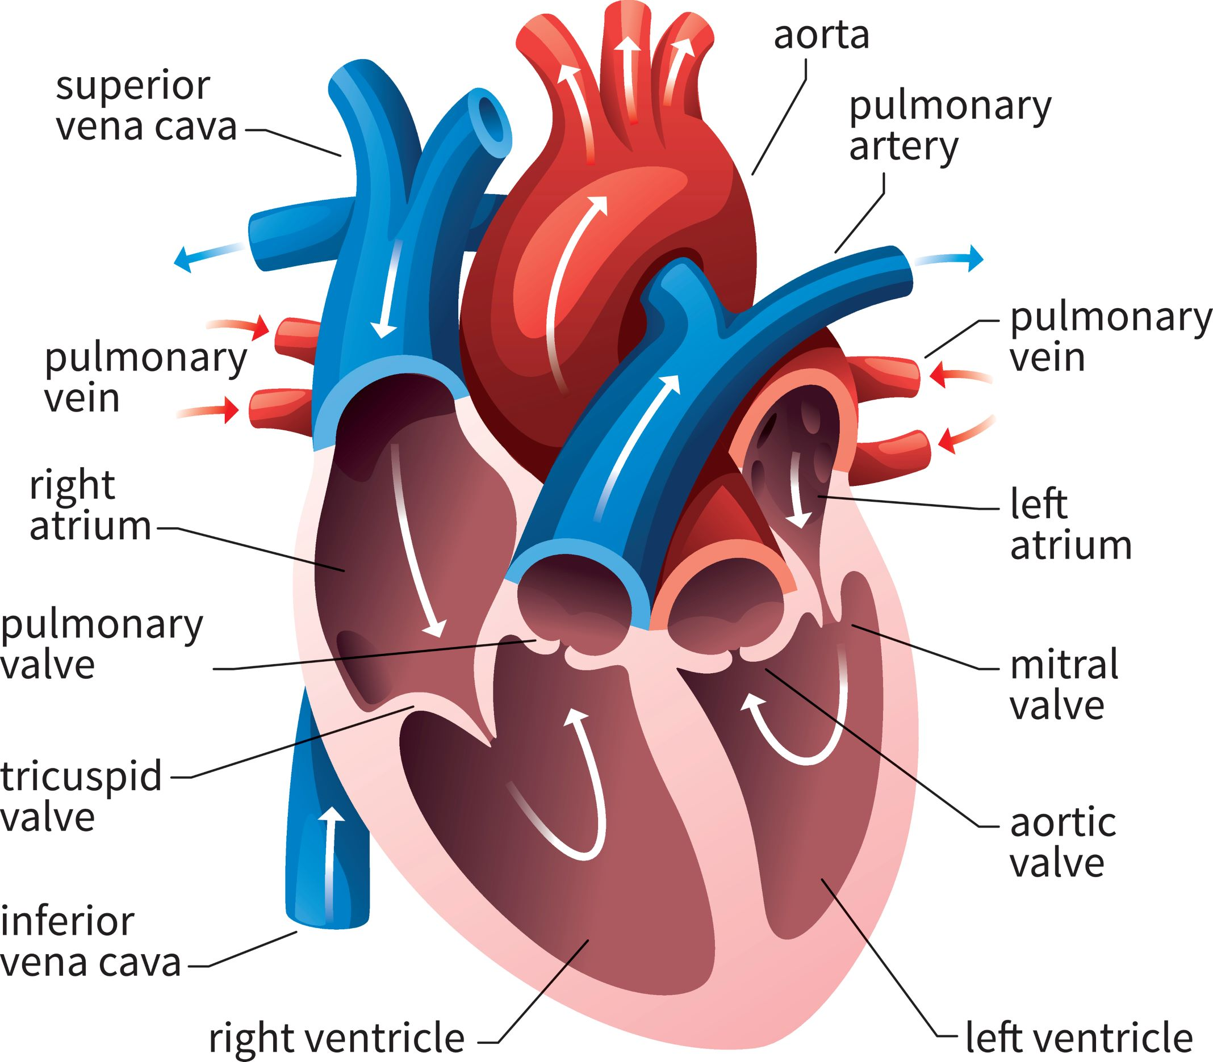
The healthy heart

Slide 5
What is Heart Failure (HF)?
NICE, 2018:
‘A clinical syndrome with typical symptoms (breathlessness, ankle swelling, and fatigue) and signs (elevated jugular venous pressure, basal crepitations, and peripheral oedema).
Caused by a structural and/or functional abnormality that produces raised intracardiac pressures and/or inadequate cardiac output at rest and/or at exercise.’

Slide 6
What causes HF? - BHF, 2022
Coronary Heart Disease, particularly ST-elevation Myocardial Infarction (STEMI)
High blood pressure and pulmonary hypertension
Structural deformities of the heart e.g cardiomyopathies
Arrhythmias e.g Ventricular Fibrillation
Amyloidosis
Anaemia
Endocarditis
Heart valve disease e.g stenosis/regurgitation
Some forms of chemotherapy
Thyroid disorders
Excessive alcohol intake

Slide 7
Important terminology
End systolic volume (ESV) – the amount of blood in ventricles at the end of systole
End diastolic volume (EDV) – the amount of blood in the ventricles at the end of diastole
Pre-load – the degree of ventricular stretch during diastole
Afterload – the force the heart needs to overcome to pump blood into the aorta
Cardiac output = Stroke volume x Heart Rate
Stroke volume = EDV – ESV

Slide 8
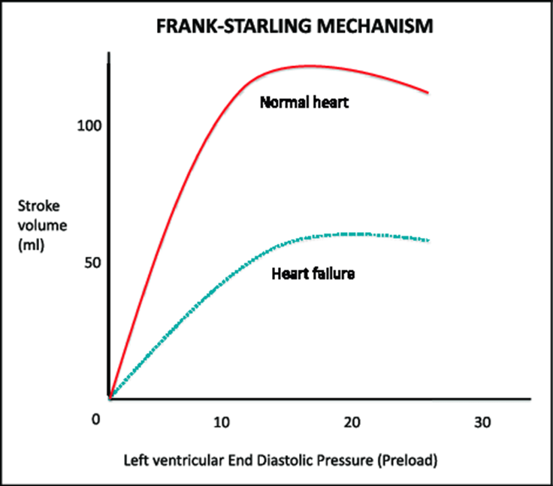
Frank-Starling Law
Explains the relationship between stroke volume and end diastolic volume
Increase in EDV = Increase in SV
The greater the stretch of the myocardium, the greater the contraction that occurs
What about an overstretched myocardium???
Notes:
Overstretched – SV and CO reduce

Slide 9
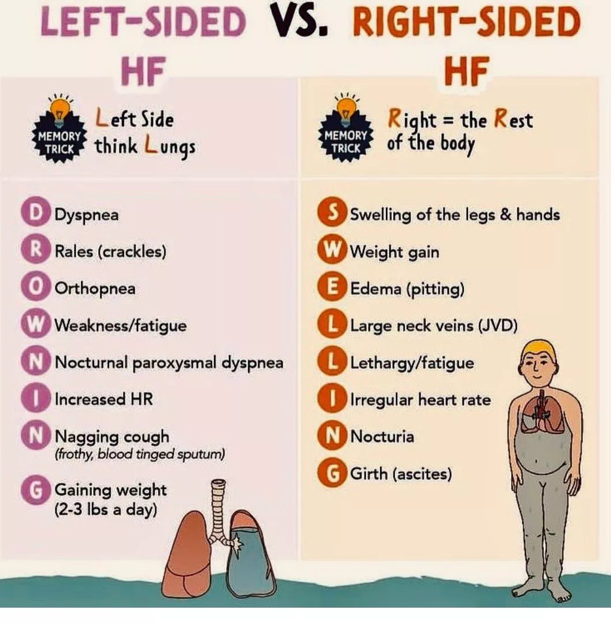

Slide 10

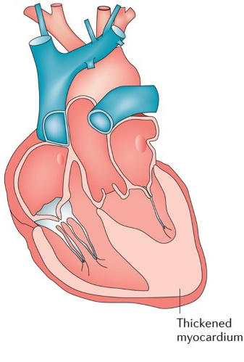
L sided HF
Notes:
Left HF = insufficient blood delivery to vital organs, back up of blood in pulmonary vein, heart works harder = thickening of L ventricle = impaired filling and relaxation = decreased SV, EF and CO.
Hypertrophy = increase chance of arrythmia

Slide 11

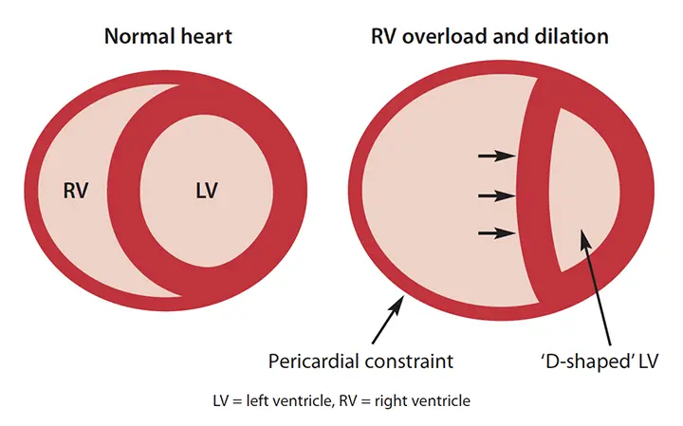
R sided HF
Notes:
R heart failure
Inability to pump blood out of pulmonary artery to lungs for oxygenation.
Build up of blood in veins = fluid moving into tissues = peripheral oedema and increased afterload.

Slide 12
Diagnosing Heart Failure – NICE, 2018
Detailed subjective history – signs and symptoms
Objective tests:
Blood tests – N-terminal pro-B-type natriuretic peptide (NT-proBNP)
Transthoracic Echocardiogram (TTE) – assess valve function, systolic and diastolic function, detect intracardiac shunts
Cardiac Magnetic Resonance Imaging (MRI) – if poor quality image on TTE
Right Heart Catheter
Assess potential for differential diagnoses:
Chest X-ray
Electrocardiogram (ECG)
Blood tests – renal, thyroid, liver, lipids, blood glucose (HbA1C), full blood count
Urinanalysis
Spirometry or Peak Flow
Notes:
NT-proBNP – high levels = poor outcomes – specialist assessment and TTE within 2/52, moderate levels = 6/52
Intracardiac shunts – abnormal pathways of blood flow, common in congenital heart disease

Slide 13
Heart Failure Classification – NICE, 2024
Classified according to:
1) Left Ventricular Ejection Fraction (LVEF)
2) The time-course of heart failure
3) Symptomatic severity – using the New York Heart Association (NYHA) Functional Classification

Slide 14
Heart Failure Classification
1 ) Left Ventricular Ejection Fraction
Left Ventricular Ejection Fraction
‘The amount of blood your heart pumps (or ejects) with each heartbeat and is a useful way of measuring Left Ventricular Systolic Dysfunction’. (British Heart Foundation, 2021)
Given as a percentage of total left ventricular output
Normal EF = 55-65%
Used to classify HF with reduced, mildly reduced or preserved EF
Notes:
Important to note that normal is NOT 100%

Slide 15
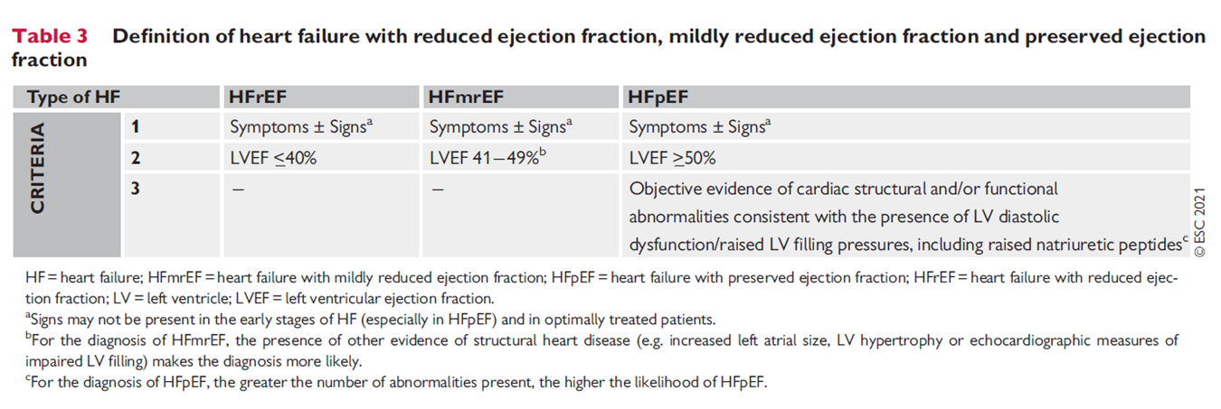
Heart Failure Classification
ESC 2001

Slide 16
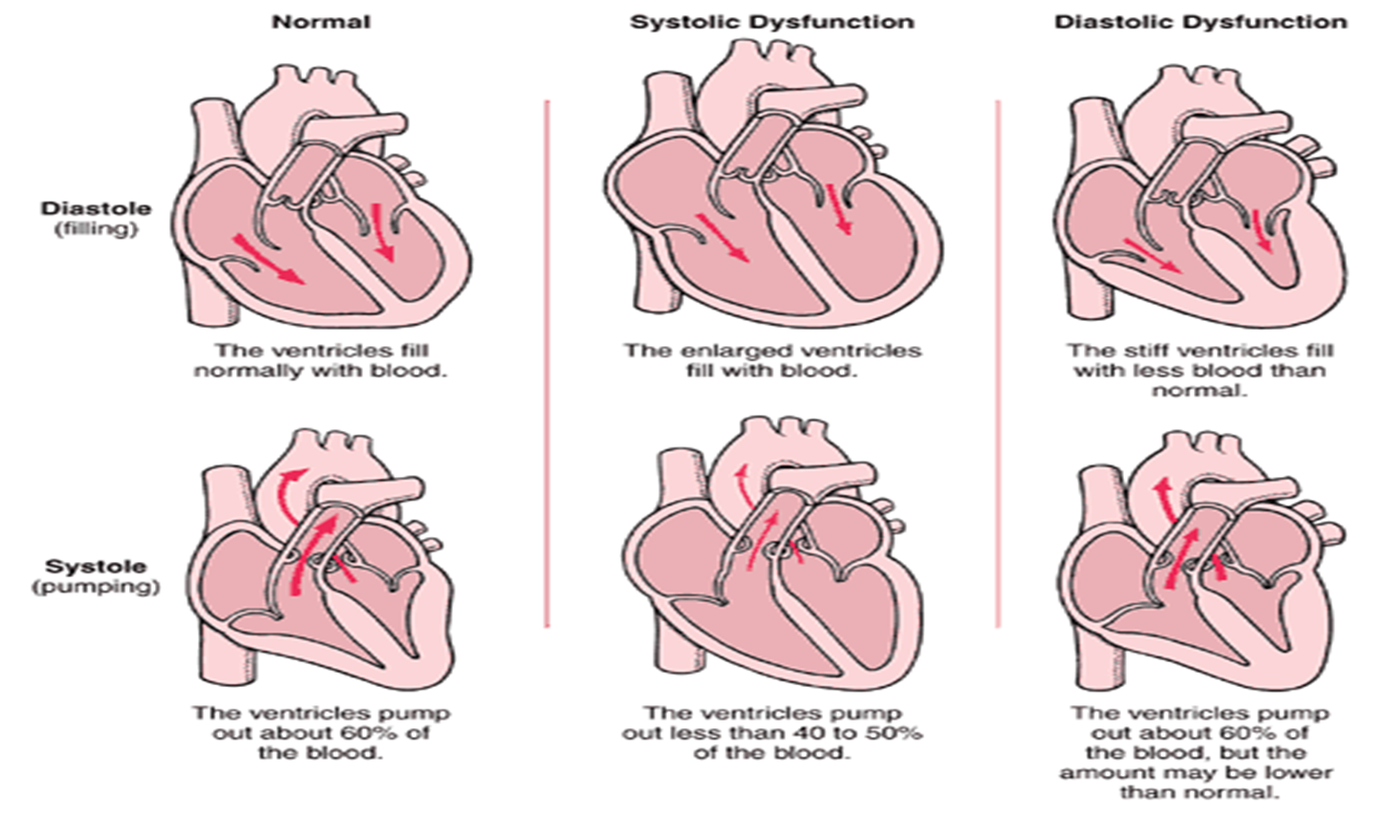

Slide 17
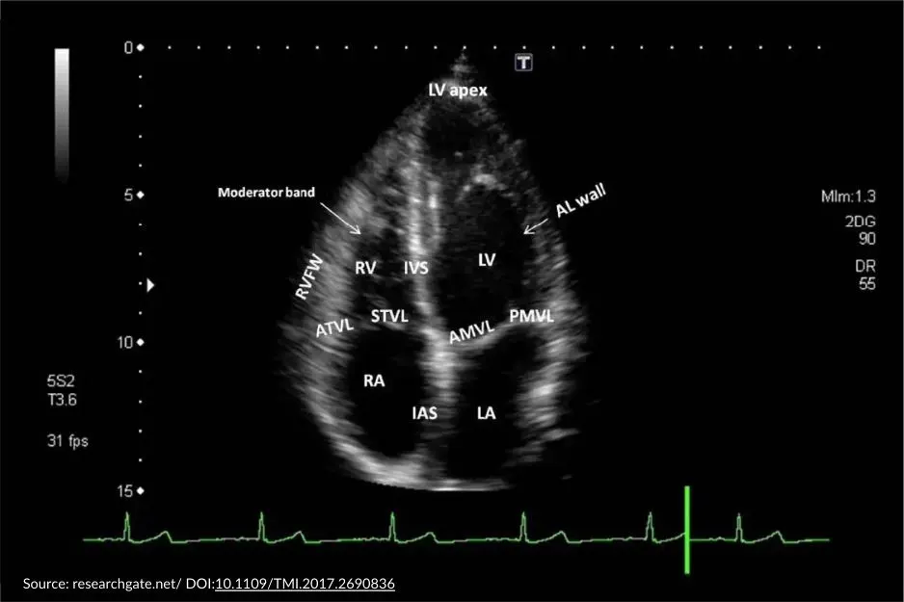
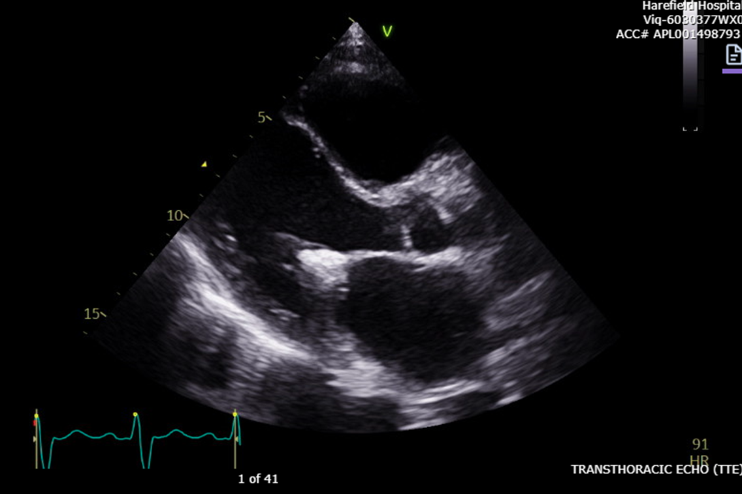
EF 20-25%
Normal EF >55%
BHF, 2021
Notes:
Systolic dysfunction – HFrEF
NOTE – Poor EF does not always mean poor fitness

Slide 18
Heart Failure Classification
2) The time-course of Heart Failure
Terms used to define the rate of onset and duration of symptoms:
Acute e.g cardiogenic shock – likely to require inotropes +/- vasopressors
Chronic
‘Acute on chronic’ or ‘decompensated’ – a period of deterioration of known chronic HF
Notes:
The overall prognosis has improved over recent decades but remains poor — often with a poor quality of life.
Acute – low cardiac output state – CI less than 2l/min and hypotension

Slide 19
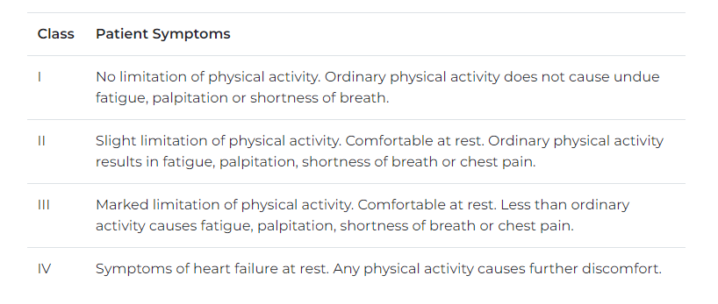
Heart Failure Classification
3) Symptom Severity
The New York Heart Association Classification (American Heart Association, 2023)

Slide 20
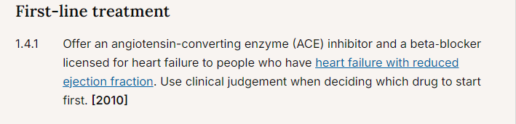
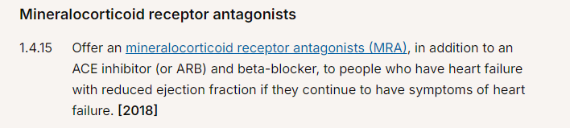
Medical management of Heart Failure – NICE, 2018
Optimisation of medical therapy:
ACE Inhibitors - Ramipril, Perindopril etc.
Betablockers – Bisoprolol, Atenolol etc.
MRAs – Eplerenone, Spironolactone
Notes:
In patients with HFrEF:
ACE – , side effects =
If ACE not tolerated, Angiotensin Receptor Blockers (ARBs) –
MRA or aldosterone antagonists – Eplerenone, Spironolactone

Slide 21
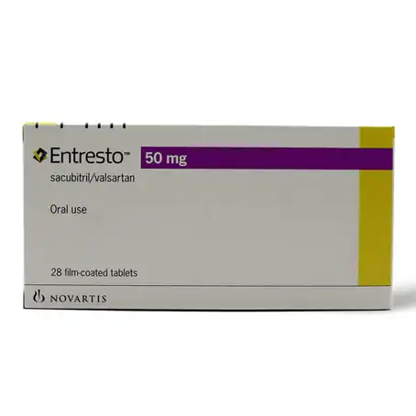


Medical management of Heart Failure – NICE, 2018
Optimisation of medical therapy – Specialist Treatment:
Medication:
Ivabridine – Reduces workload of heart by reducing HR
Sacubitril-Valsartan (Entresto) – Vasodilator and decreases sodium and fluid build up
Hydralazine - Vasodilator
Digoxin – anti-arrythmic
Dapagliflozin
Implantable Cardioverter Defibrillator (ICD)
Cardiac Resynchronisation Therapy Device (CRTD)
Notes:
Ivabridine – NYHA II or above – slows HR
Sacubitril Valsartan – Entresto
Dapa – usually used for diabetes, but has been shown to improved LV contractility

Slide 22
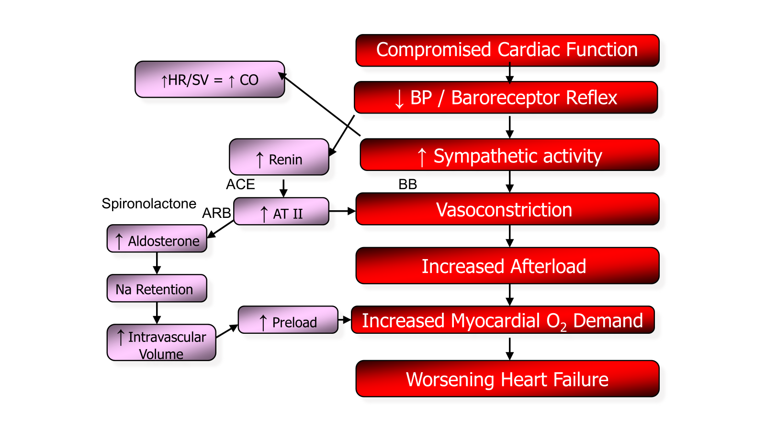
Notes:
Decreased cardiac output
Decreased Stroke volume
Poor systolic and diastolic function
Loss of internal contractility
Alterations in signal transduction
Alterations to the proteins or signal receptors in the heart

Slide 23
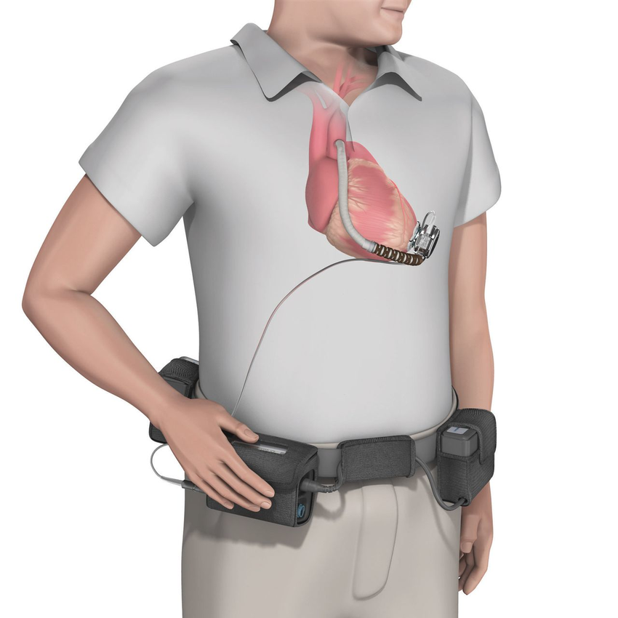
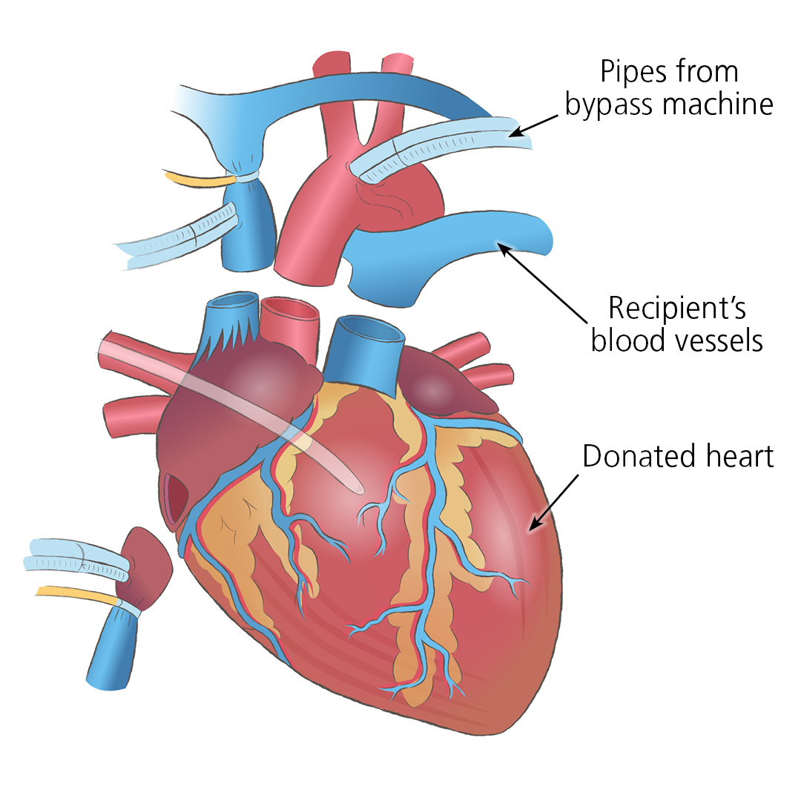
Medical management of Heart Failure – NICE, 2018
End-stage HF
Deterioration despite optimal medical therapy
Referral to specialist centre:
MDT decision-making – Transplant listing, Mechanical Circulatory Support E.g Left Ventricular Assist Devices.
NHS Blood and Transplant
BHF, 2014

Slide 24
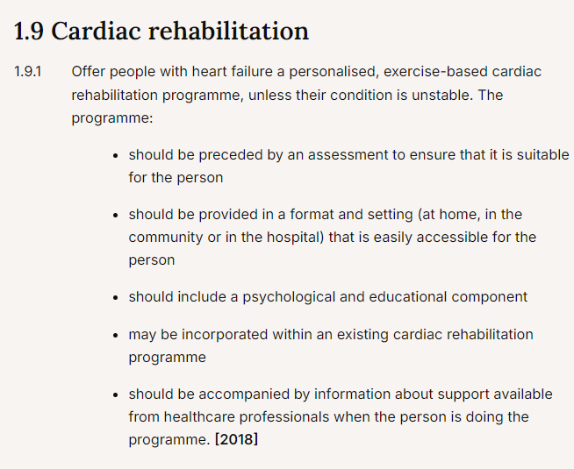
Non-medical management of Heart Failure – NICE 2018
Cardiac Rehabilitation
Lifestyle advice – diet, smoking cessation, limiting alcohol intake
Palliative care in patients whose symptoms are worsening despite optimal specialist treatment – symptom management, advanced care planning as appropriate

Slide 25
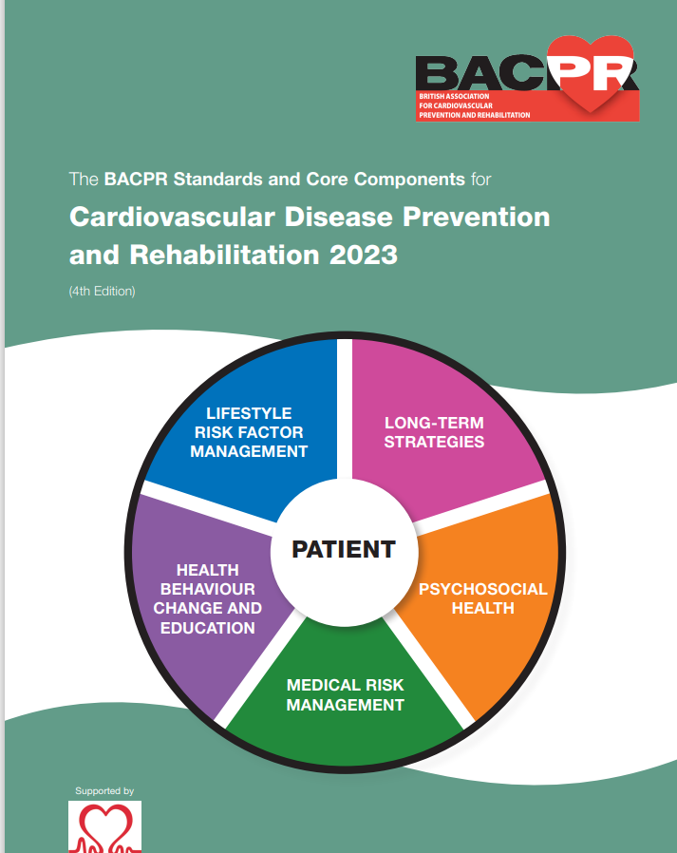
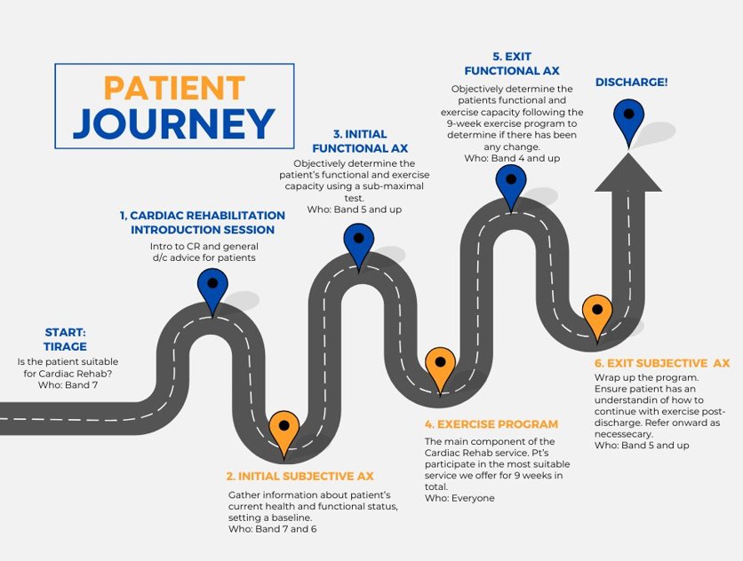
Non-medical management of Heart Failure – Cardiac Rehabilitation

Slide 26
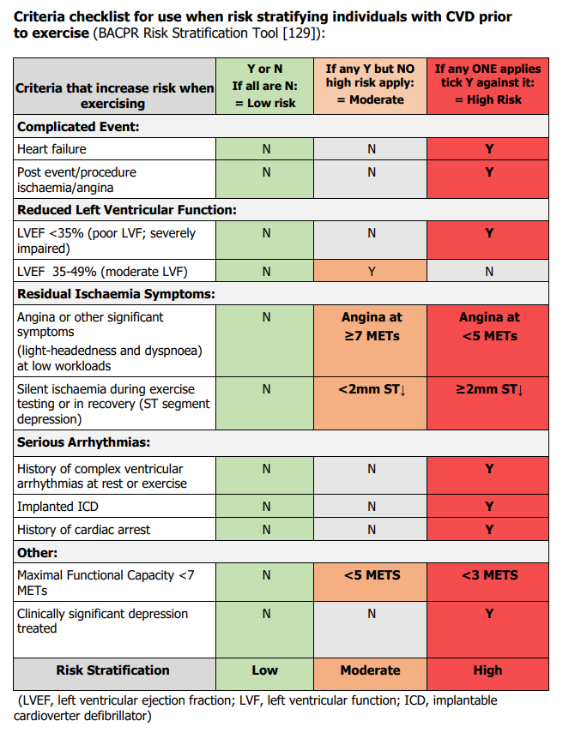
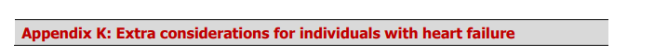
Non-medical management of Heart Failure – Cardiac Rehabilitation
ACPICR, 2023
Cardiac Rehabilitation – Exercise-specific:
Risk stratification – High risk if EF <35%, Moderate if 35-49%
Sufficient warm up and cool down
Aerobic training – ‘start low and go slow’
Aerobic exercise intensity – low to moderate (40-70% Heart Rate Reserve (HRR) or Borg RPE 10-14)
Resistance training!!!
Other considerations:
Energy conservation – aids/equipment, start position
Flexible programme – accounts for ‘good’ and ‘bad’ days
Postural training and core strength
Avoid abrupt postural changes
Maintain venous return – keep the feet moving!
Notes:
Warm up and cool down – reducing risk of ischaemia, arrythmias, post-exercise hypotension
Adapting periods of CV depending on physical fitness – deconditioned = short periods of CV then active recovery, resistance training or seated programme
RT – if very deconditioned, consider RT only programme
HRR – Max HR-Rest HR – use Keteyian regression equation in HF

Slide 27
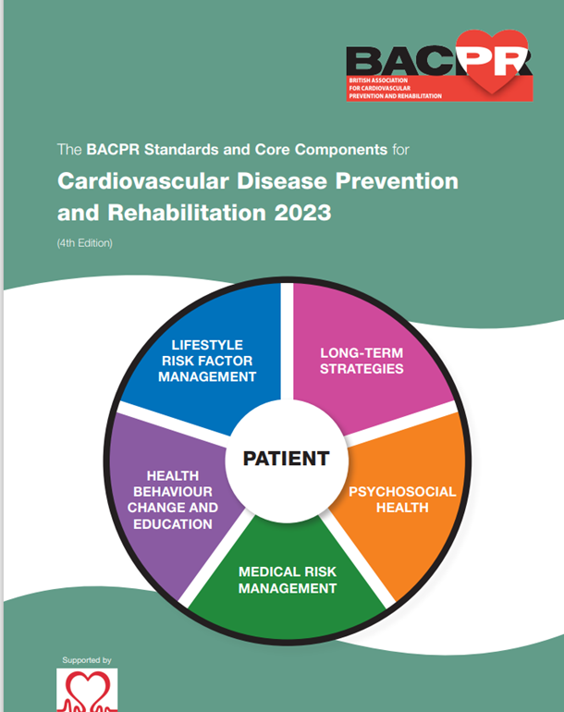
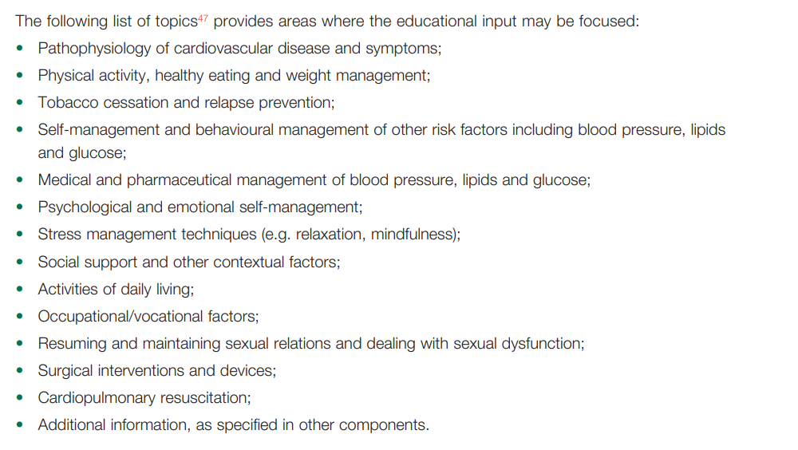
Non-medical management of Heart Failure – Cardiac Rehabilitation
BACPR, 2023
Cardiac Rehabilitation - Education

Slide 28
Summary points:
Heart Failure is a multi-organ condition that can cause a variety of symptoms
There are a vast number of causes of Heart Failure
Heart Failure diagnosis requires extensive assessment – both subjectively and objectively
Heart Failure is classified in three ways – LVEF, disease time-course and symptomatic severity
Management of Heart Failure requires a combination of medical and non-medical management strategies, and involves a wide range of MDT members
Any questions?

